Slide 1

The United Reformed Church Pension Plan Section of the Aon MasterTrust
‘How to’ instructions

Slide 2







What this guide covers
How to access your member account
How to change your investments
£
How to nominate your beneficiaries
How to transfer in
How to change your target retirement age
How to access Well One Money
How to change your contributions

Slide 3

How to access your member account

Slide 4

How to access your member account
Your member account can be accessed:
On your computer, laptop or tablet by visiting www.theaonmastertrust.co.uk
On your phone by downloading the ‘Aon Online Benefits’ App
What is my user ID
Your user ID can be found in your welcome letter
What is my password
This was emailed to you by The Aon MasterTrust Admin Team
If you can’t find your User ID or password, please call the Technical Support Team on 0330 123 2045, or email admin@theaonmt.co.uk

Slide 5
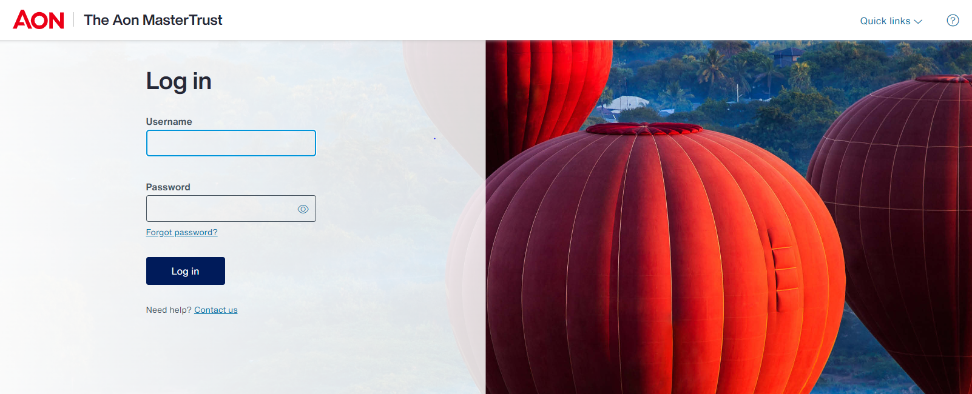
Logging in to your member account – via the website
Visit www.theaonmastertrust.co.uk
Enter your Aon MasterTrust User ID and Password
If you can’t remember your password, click ‘Forgot password’ and you will be able to reset it

Slide 6
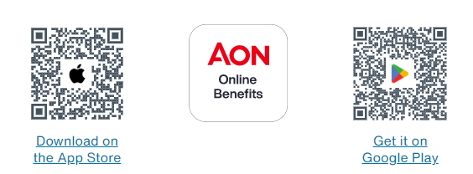
Logging in to your member account – via the app
Download the Aon MasterTrust App from your App store – search for the AON Online Benefits or AON OLB
Open the app and accept the push notifications when prompted.
Enter the access code: 0468 and click ‘Search’.
Once on the login page, enter your Aon MasterTrust User ID and password and click ‘Log in’

Slide 7

How to nominate your beneficiaries

Slide 8
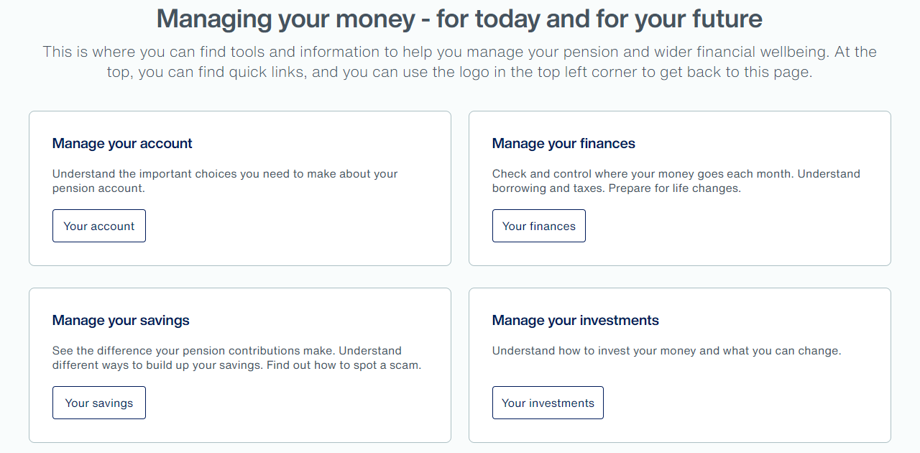
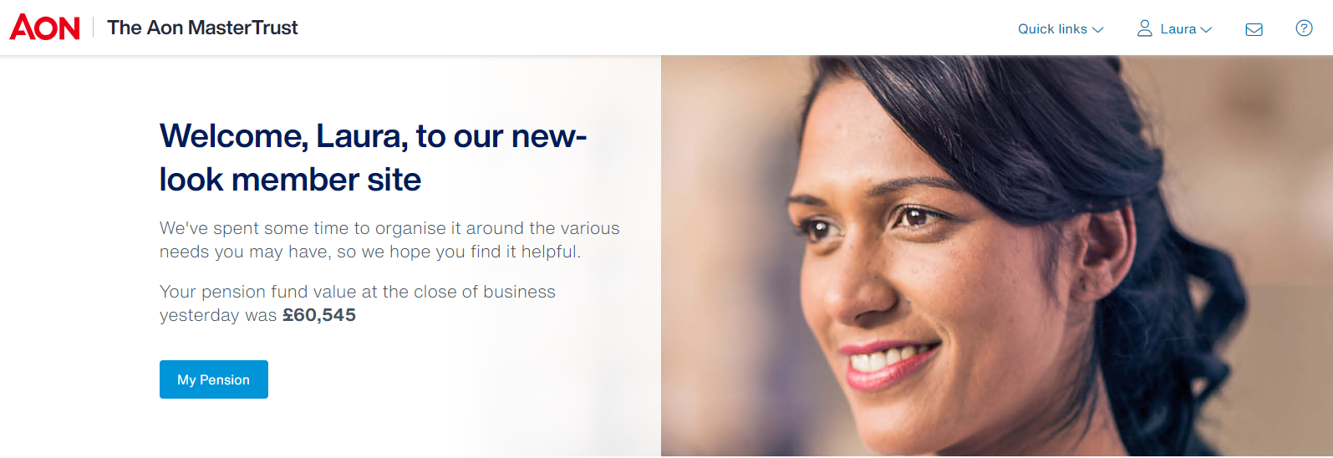

How to nominate your beneficiaries
Once you have logged into the member site, you can explore information about death benefits under ‘Manage your account’ from the homepage and selecting ‘Looking ahead’:
To elect your beneficiaries for your pension, or to make a change to your existing nominations, select ‘My Pension’ on the homepage

Slide 9
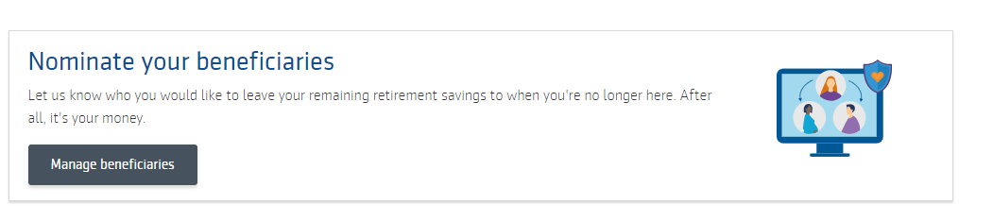
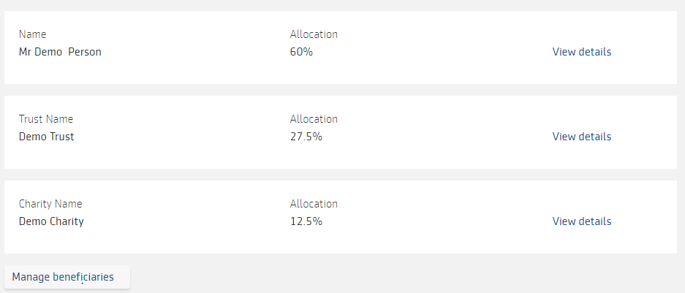
How to nominate your beneficiaries
You can select ‘Nominate your beneficiaries’ ‘from the homepage
You will see who you have nominated as your beneficiaries and make changes as required by selecting ‘Manage beneficiaries’

Slide 10
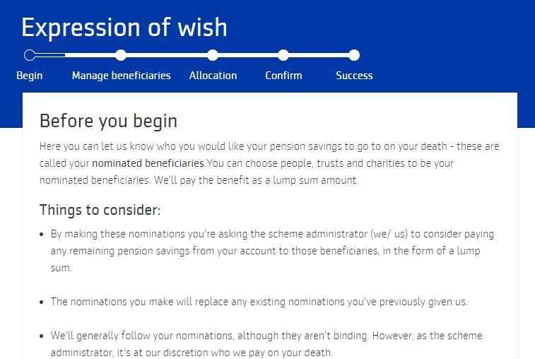
How to nominate your beneficiaries
You will now be able to go through a five-step process to make changes to your beneficiaries
You will need to select ‘Start’ at the bottom of the page
Add your beneficiaries
Add the allocation
Review and confirm

Slide 11
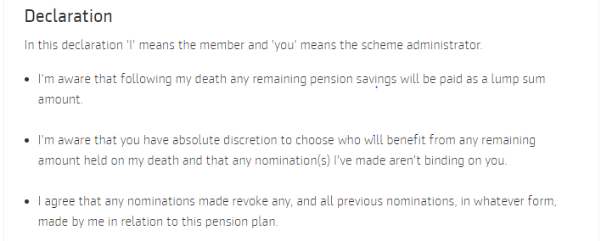
How to nominate your beneficiaries
You will need to complete a declaration before submitting your elections

Slide 12

How to change your target retirement age

Slide 13
How to change your target retirement age
To make a change to your Target Retirement Age, select ‘My Pension’ on the homepage

Slide 14
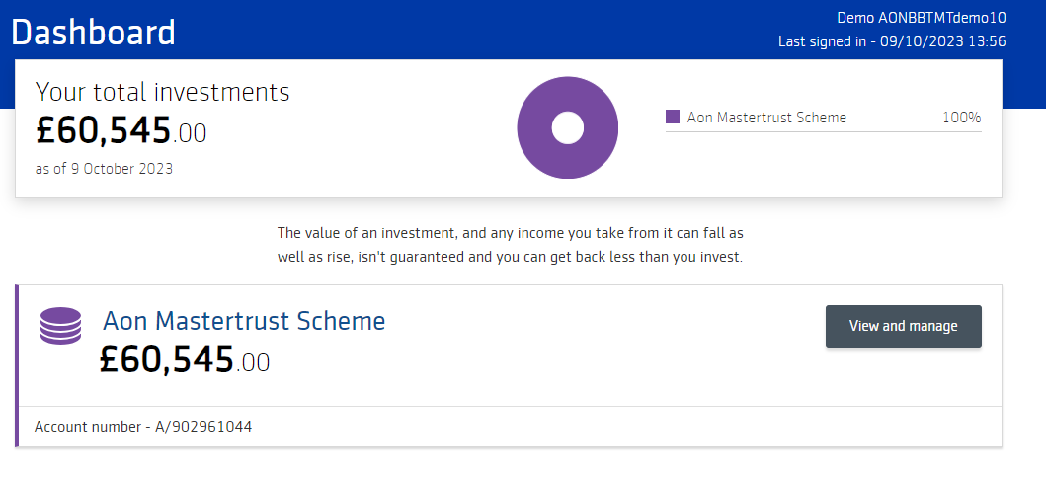
How to change your target retirement age
It will take you to your ‘Dashboard’ in the transactional part of the website
To make a change to your target retirement age, select ‘view and manage’ and you will enter the area of the site that allows you to make any changes you may need to your pension
You will need to acknowledge and accept our Terms & Conditions and Privacy Policy at this stage

Slide 15
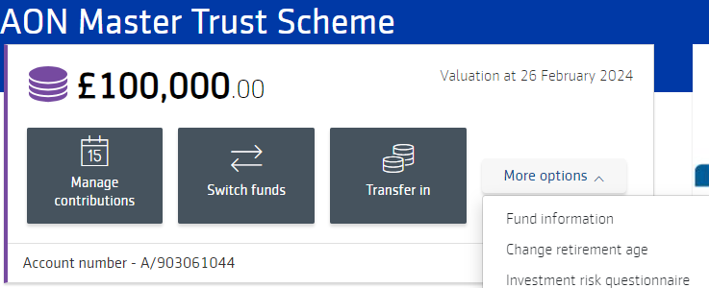
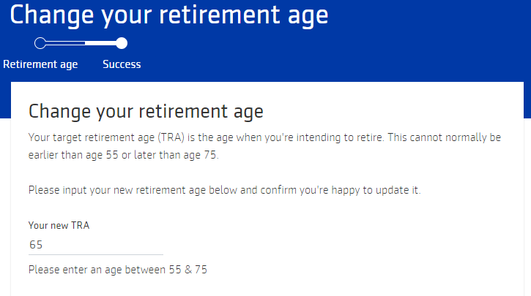
How to change your target retirement age
You will need to select ‘More Options’ and then ‘Change retirement age’ to start the process
You will now be able to go through a two step process to make changes to your target retirement age

Slide 16
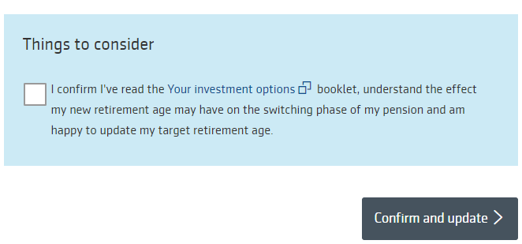
How to change your target retirement age
You will need to read and confirm the ‘Things to consider’ box, before hitting the ‘Confirm and update’ button

Slide 17

How to change your contributions

Slide 18
How to change your contributions
You can make changes to your contributions at any time by contacting payroll.

Slide 19

How to change your investments

Slide 20
How to change your investments
Once you have logged into your member account, you can explore information about ‘Managing your finances’ from the homepage:
To make a change to your investments, select ‘My Pension’ on the homepage

Slide 21
How to change your investments
It will take you to your ‘Dashboard’ in the transactional part of the website
To make a change to your investments, select ‘view and manage’ and you will enter you will enter the area of the site that allows you to make any changes you may need to your investments
You will need to acknowledge and accepting our Terms & Conditions and Privacy Policy at this stage

Slide 22
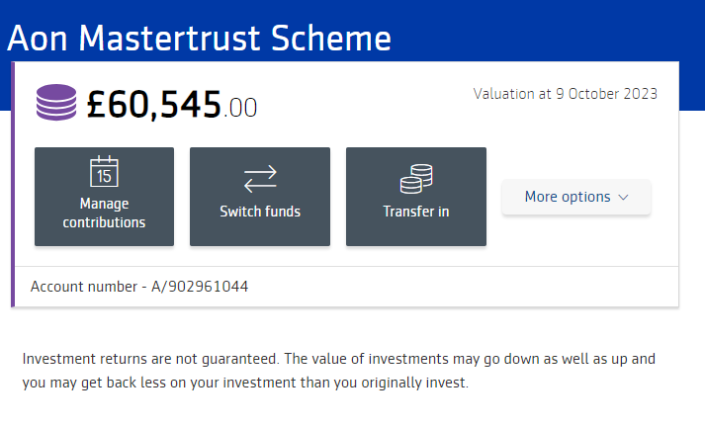
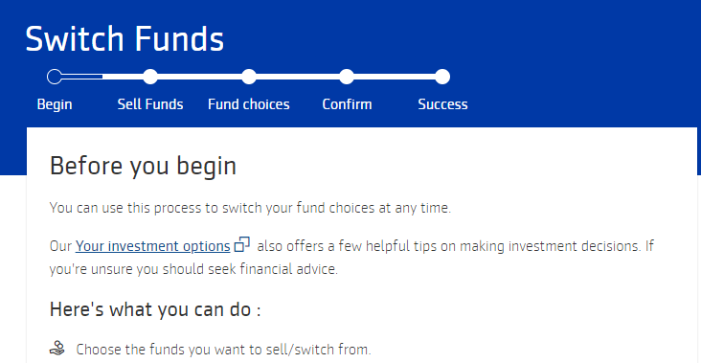
How to change your investments
You will need to select ‘Switch funds’ to start the process
You will now be able to go through a five step process to make changes to your contributions
You will need to select ‘Sell Funds’ at the bottom of the page

Slide 23
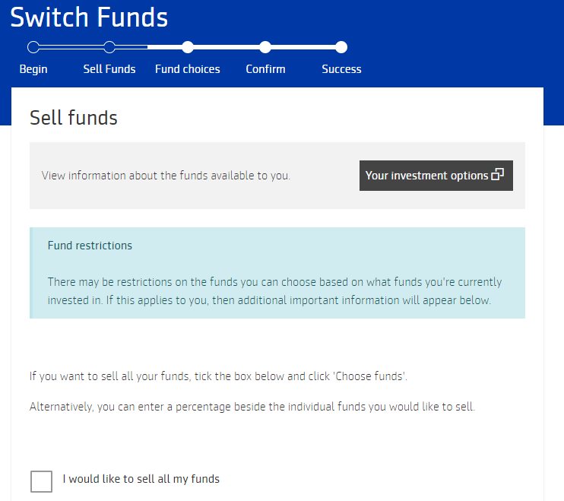
How to change your investments
You will be able to select the funds you wish to sell
You then select ‘Choose funds’ at the bottom of the page

Slide 24
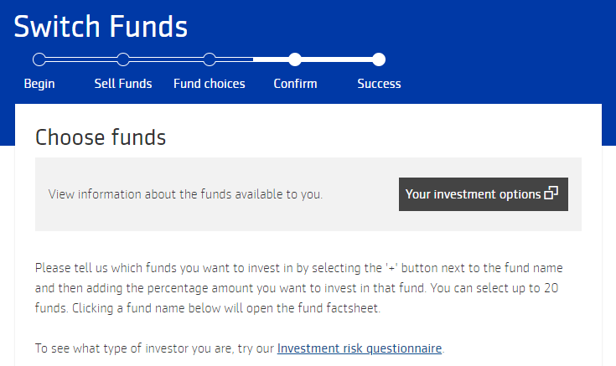
How to change your investments
You will be able to select the funds you wish to invest in and the allocations of each fund
You will need to confirm whether future contributions should be allocated to your new investment (and if not select the alternative fund)
Confirm your selections at the bottom of the page

Slide 25
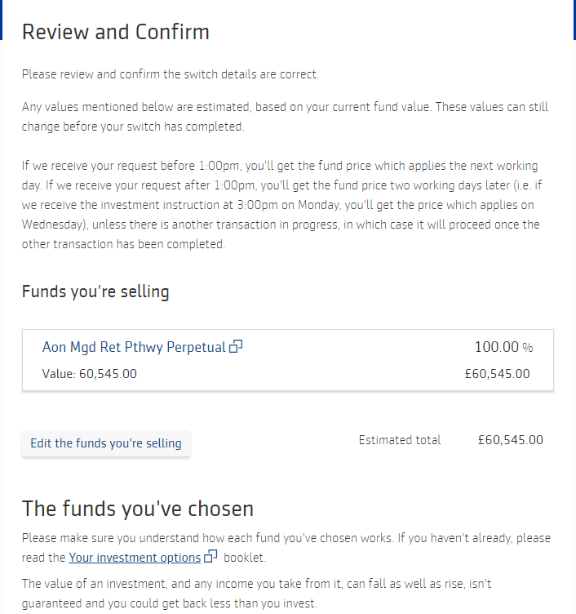
How to change your investments
You will then need to confirm review your changes before selecting ‘confirm and update’

Slide 26

How to transfer in

Slide 27
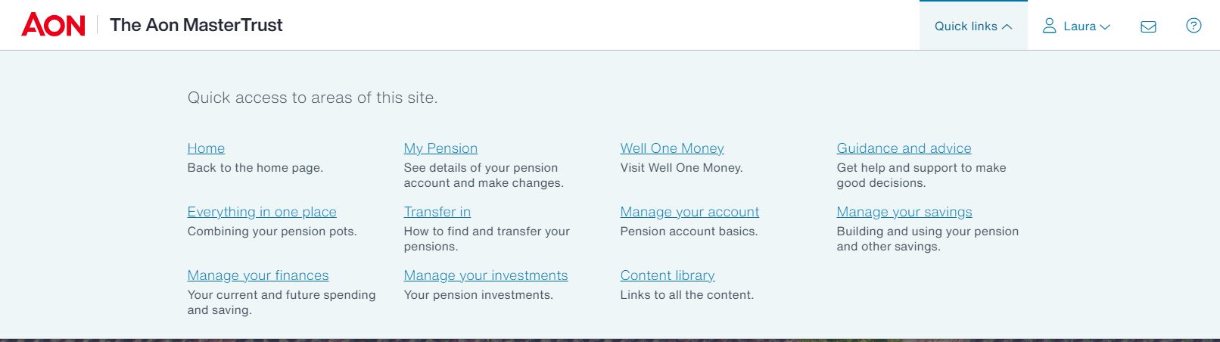
How to transfer in
Once you have logged into your member account, you can explore information under ‘Manage your savings’ from the homepage:
To start a transfer in process, you can select ‘Transfer in’ under the ‘QuickLinks’ tab on the homepage

Slide 28
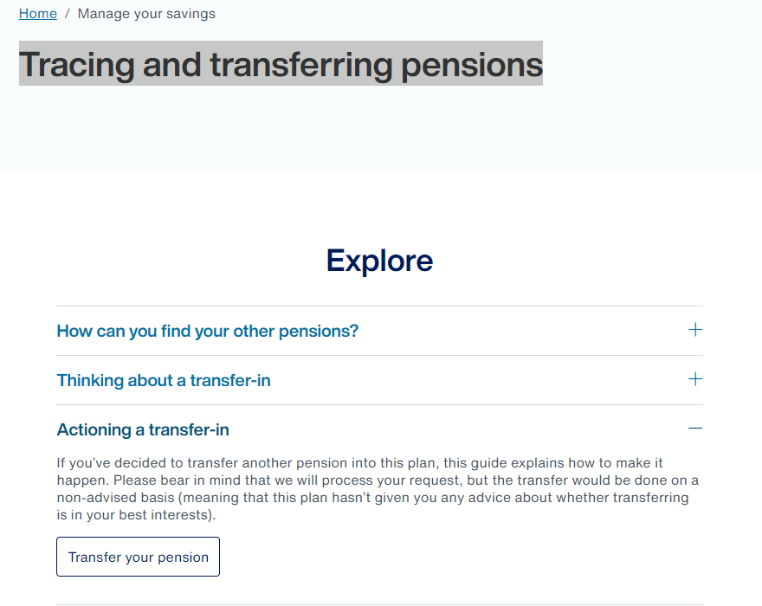
How to transfer in
It will take you to a ‘Tracing and transferring pensions’ page and you can select ‘Transfer your pension’ under ‘Actioning a transfer-in’

Slide 29
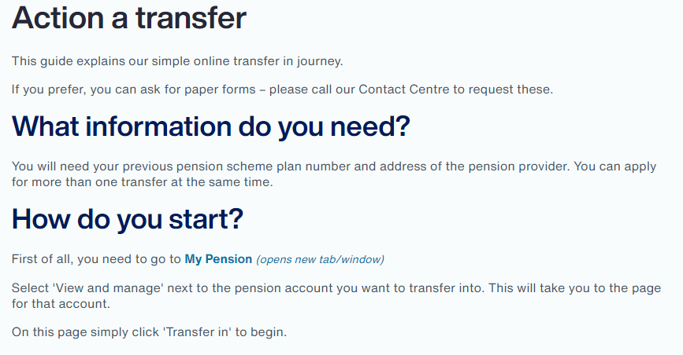
How to transfer in
It will take you to the ‘Action a transfer’ page and you can select ‘My Pension’ under ‘How do you start?’
This will take you to your ‘Dashboard’ in the transactional part of the website

Slide 30
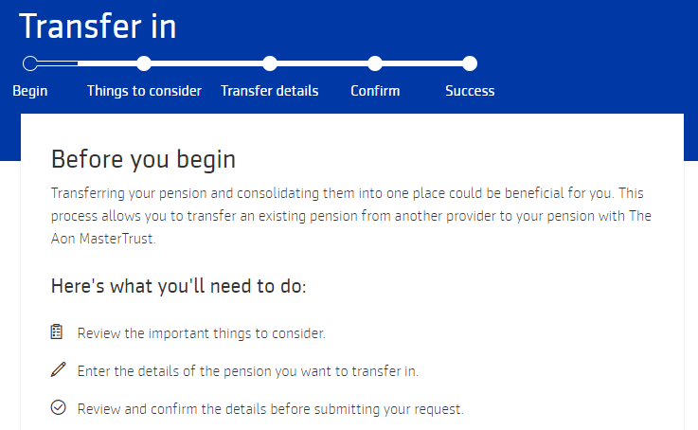
How to transfer in
You will need to select ‘transfer in’ to start the process
You will now be able to go through a five step process to undertake your transfer in
You will need to select ‘start’ at the bottom of the page

Slide 31
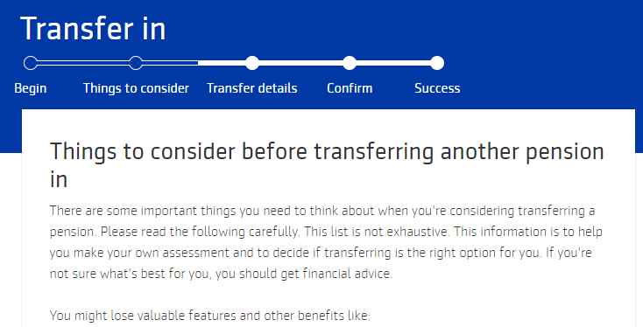
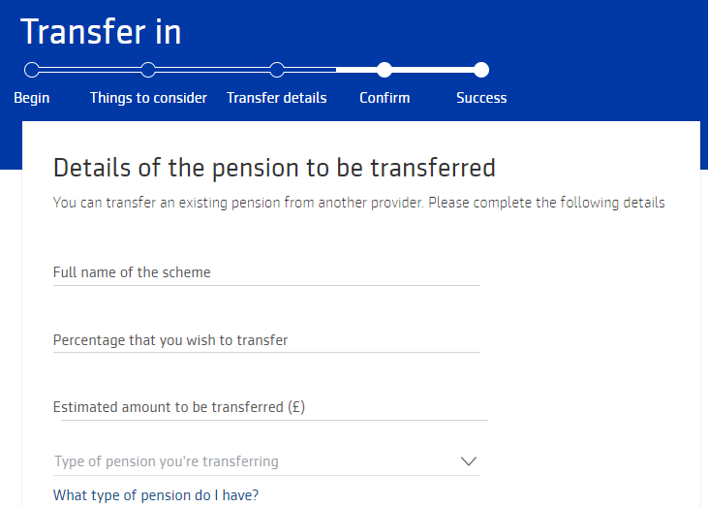
How to transfer in
You will need to read ‘Things to consider’ before you select ‘Enter your transfer details’ at the bottom of the page
You can then enter your transfer details, before selecting ‘Review and confirm’ at the bottom of the page

Slide 32
How to transfer in
Once you have confirmed your transfer request, the Aon MasterTrust will engage with your previous scheme(s) to initiate the transfer and send you forms to sign to authorise the transfer
In many cases, all the work involved to transfer your money can then be completed by the Aon MasterTrust. You can track the progress of the transfer by returning to the transfer in page
Once the transfer has been completed, we'll send you confirmation of the monies received and invested.
Please note that if you would prefer to, you can initiate the request by contacting the Aon MasterTrust through the The United Reformed Church member helpline

Slide 33

How to access Well One Money

Slide 34
How to access Well One Money
By using Well One Money you can:
  view information about your investments, bank accounts, and credit cards, loans and mortgages, alongside your pension;
  take control of your spending and saving
  access discounts from shops you use regularly
Once you have logged into your member account, you can explore information about Well One Money under the ‘managing your finances’ tile on the homepage:

Slide 35
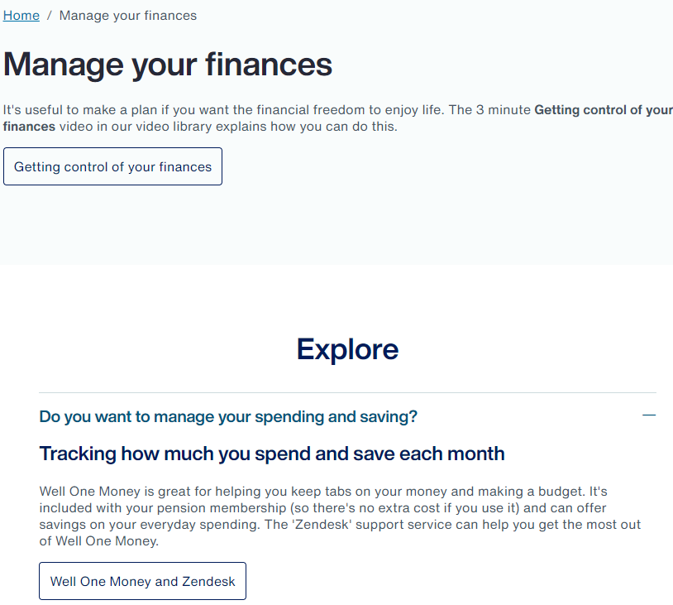
How to access Well One Money
Under ‘Manage your finances’ you can select ‘Well One Money and Zendesk’ under ‘Do you want to manage your spending and saving’
This will take you to a separate page with video instructions and details on how you access and register for Well One Money

Slide 36
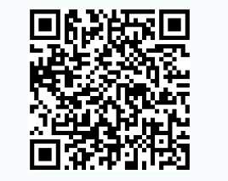
How to access Well One Money
To access Well One Money, you will need to enter your email that is linked to your pension account — you can check this in your Profile on this site. You will have been asked to set a password for Well One Money when you activated your account
The site can be accessed via www.wellonemoney.co.uk or by downloading the Well One Money App

Slide 37

Useful information

Slide 38


Where to go for more support
  You can access low-cost advice if you want it from Origen
  This will enable you to determine your retirement aspirations
  Check that your pension is on track to support your aspirations
  Financial advice isn’t just for retirement, by planning from an earlier age it increases the chances that your retirement aspirations will be met
  As an Aon MasterTrust member, you benefit from a preferential rate of £600 which includes VAT. This fee can be paid direct, or you can pay part or all from your pension fund using Pension Advice Allowance or Adviser charging options
  To contact Origen phone 0800 124 4886 or email AonMasterTrust@origenfs.co.uk
  You can also book an appointment with MoneyHelper, a Government sponsored service, who will give you free guidance
  The Government’s Pension Tracing Service can help you find old schemes you have previously contributed to

Slide 39




Further information and support
Website: www.theaonmastertrust.co.uk
(using login details in your welcome pack, if you have forgotten your details you can call The United Reformed Church Pension Plan Technical Support Team)
App: App store – search for Aon’s Aon Online Benefits App.
Login in using your Aon MasterTrust User ID and password and use 0468 as the pin for the App (you can then switch on finger-print or Face ID technology)
The United Reformed Church member helpline: 0345 646 1788
Email: admin@theaonmt.co.uk

